Slide 1
CS 352 Introduction to Usability Engineering
Concepts and Prototypes

Slide 2
Concepts (Conceptual Model)
Pre-prototype
Explore how to address some aspect
Interface metaphor (desktop, etc)
Paradigm (WIMP, wearable, …)
Interaction type (manipulating, exploring, …)
A brainstorming-like tool
Consider several concepts
There should be some bad ideas!
Don’t get too attached to one
Don’t spend too much time on any

Slide 3
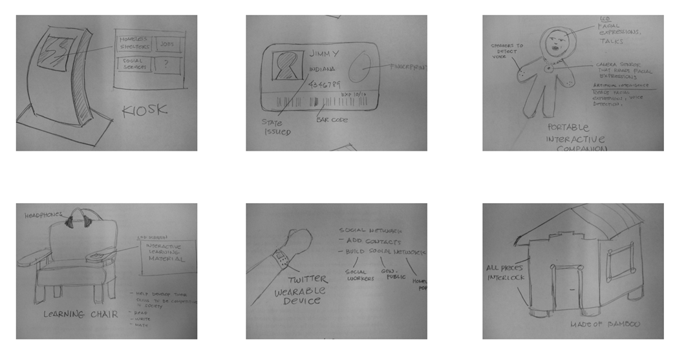
Inklings of a Design …

Slide 4
Exercise
Sketch 3 or more concepts for an online grocery
High level brief overview
What all considerations do you find?
Are they true for all options?

Slide 5
Is Your Concept Good?
Question to consider (#2-6 are for metaphor concepts)
Does it solve the progblem?
How much structure does it provide?
How much of it is relevant to the problem?
Is it easy to represent?
Will your audience understand the metaphor?
How extensible is the metaphor?

Slide 6
Exercise (cont)
Choose one of your concepts you previously sketched
Answer the 6 questions about it

Slide 7
Prototypes
Flesh out a concept with enough detail
To communicate/understand the UX in detail
To understand user problems with our ideas (this class)
To communicate with stakeholders, media, etc.
Low fidelity prototypes ideal for some purposes
Cheap
Force enough attention to detail
This focus may change at different stages of the project

Slide 8
Higher Fidelity Prototypes
Useful:
AFTER getting through lower fidelity ones first
Get at details of design (layout, colors, icons, etc.)
Front end finished with widgets polished up
Behavior/data is hard-coded (no back-end)
For stakeholders, media, etc.

Slide 9
Low Fidelity Prototypes
Our starting point
How low can you go?
Lowest fidelity: paper
At first sketches
Later can be more polished
Static paper vs “interactive” paper
There are tool-supported variants of the above
Details next …

Slide 10
Paper Prototypes
Static Paper
For communicating among the team
Usually done as
a written use case or
a sketched storyboard or
A sketched state machine
Very detailed paper prototype (next slide)

Slide 11
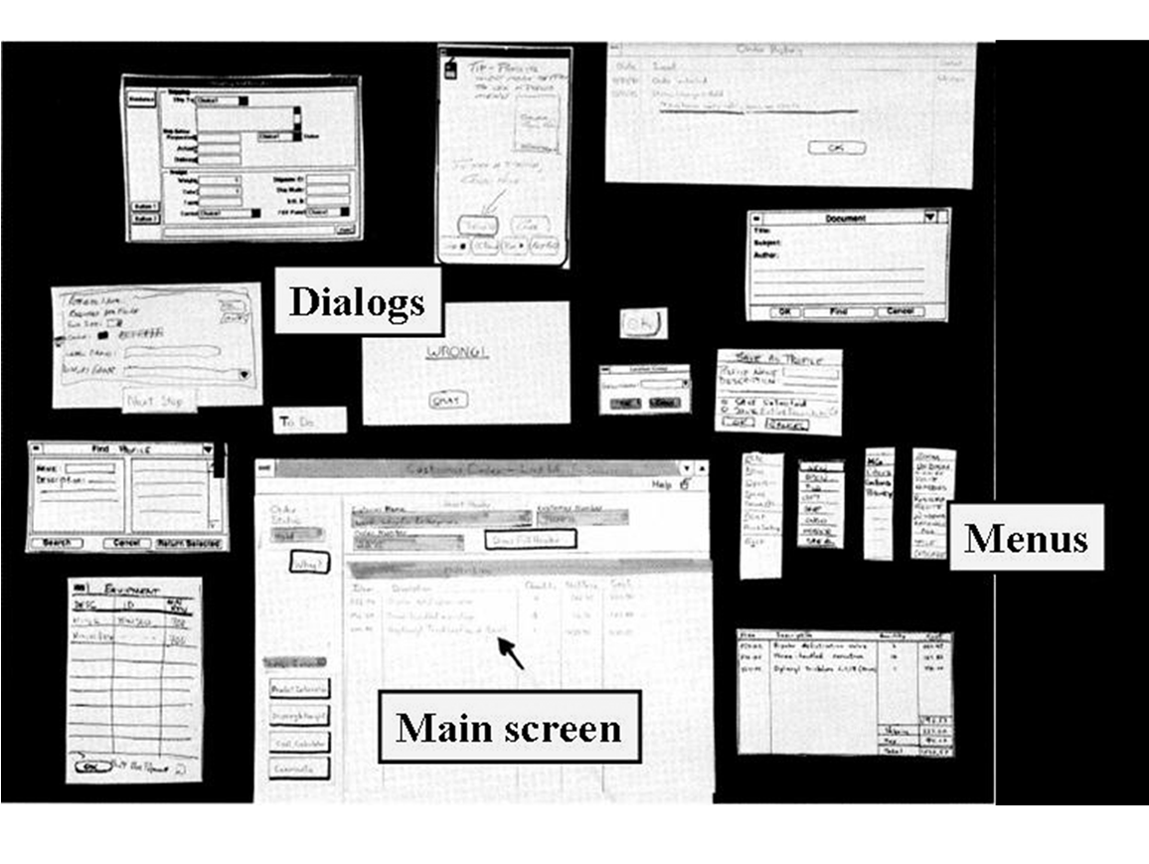

Slide 12
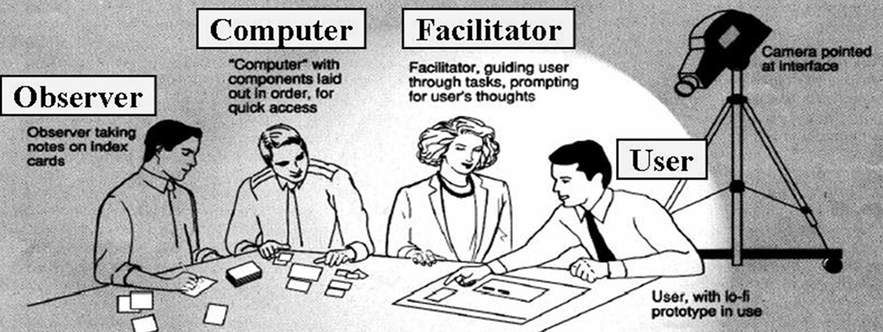
Paper Prototypes
Dynamic (interactive) paper
For evaluating with user at very low cost

Slide 13
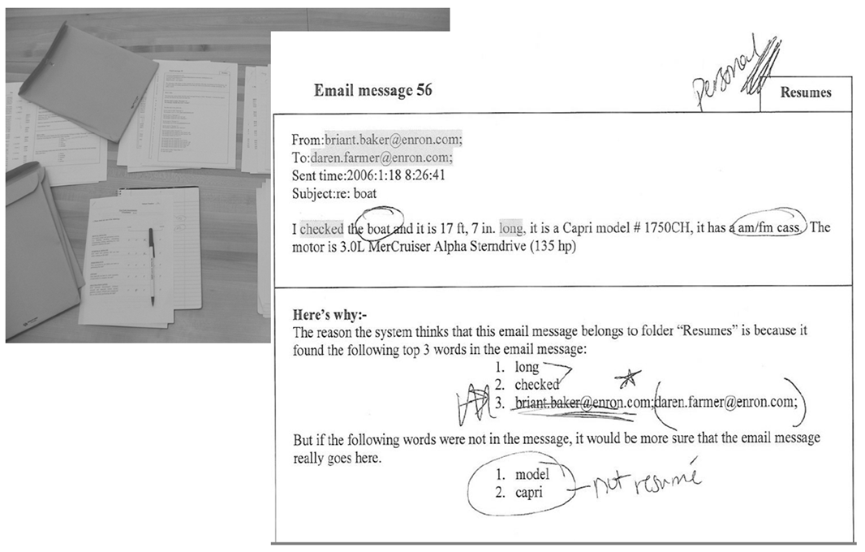
Low Fidelity Prototype
Set up with pens, printouts, table

Slide 14
CS 352 Prototyping
We start with a static paper prototype
You will make a series of increasingly detail prototypes
Ending with a final interactive paper prototype
You will post each iteration to get feedback from classmates
Helps make your group project stronger!

